Slide 1
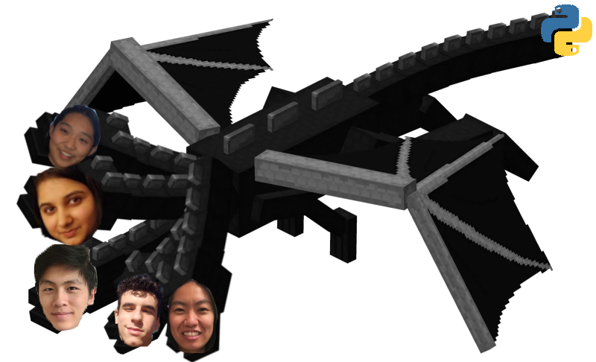

Track 2: L2 Anonymization
Data Dragons

Slide 2
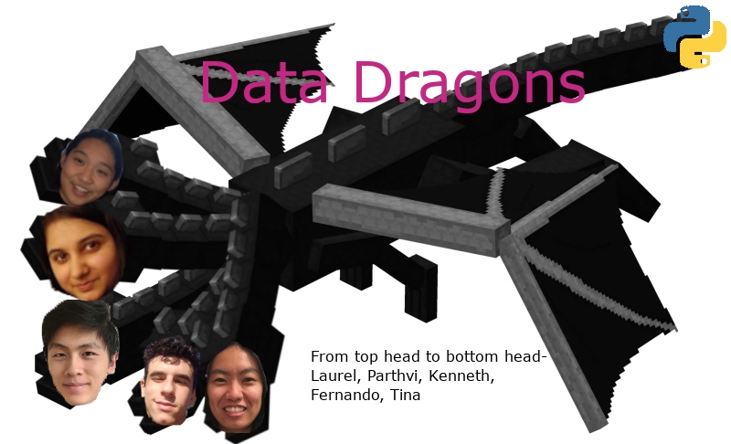
Meet the Team!
Kenneth Ding
Fernando Rodriguez
Parthvi Bhutani
Laurel Xiang
Tina Lai

Slide 3
Overview
K-anonymization
Encryption algorithm
Algorithm based on chaos and data perturbation

Slide 4
Algorithm 1
A flexible approach to distributed data anonymization
https://www.sciencedirect.com/science/article/pii/S1532046413001937

Slide 5
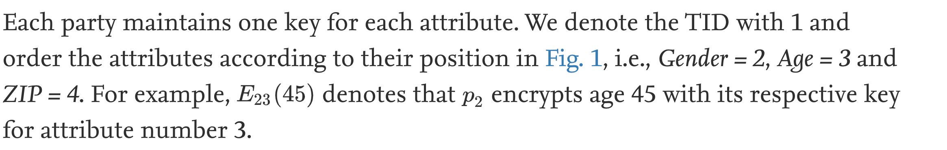
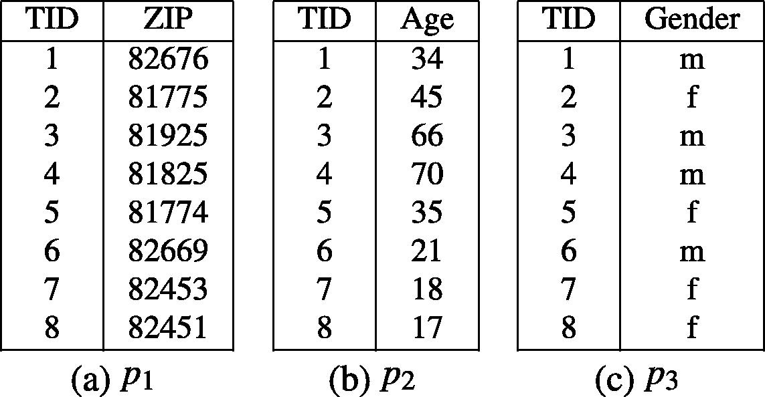
Example
Fig. 1

Slide 6
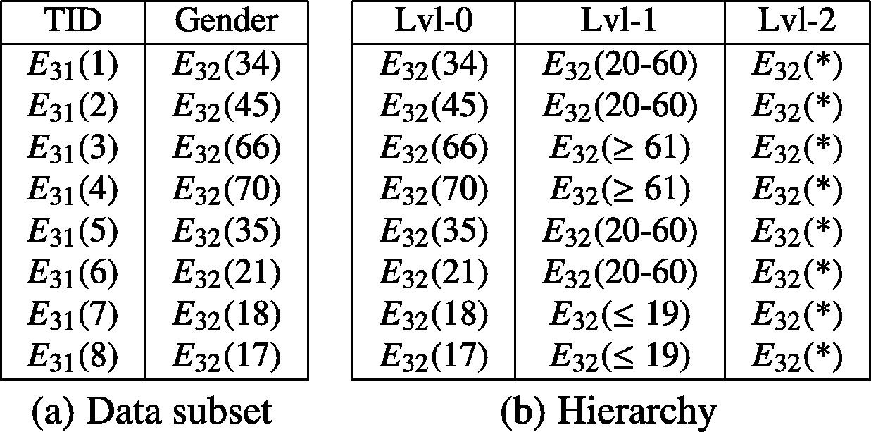
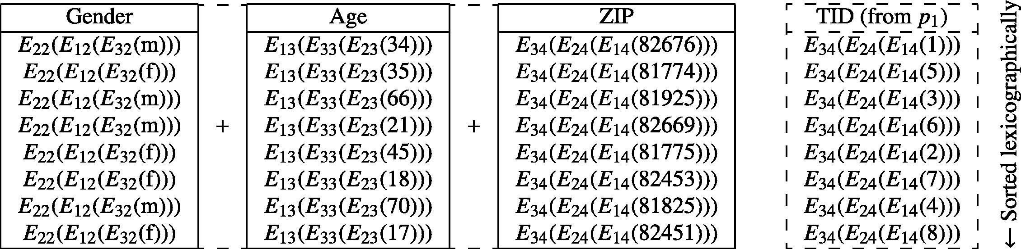
Integrating the global encrypted dataset
Fig. 2
Fig. 3

Slide 7
Algorithm 2: data anonymization using chaos and data perturbation techniques
Chaos function → efficiently performs data anonymization based on probability of randomness in data.
Advantages
Filters out crucial values that are in compliance with data frequency.
Algorithm is more efficient at preserving utility without losing anonymization.
Can be applied on both numerical and categorical attributes.
Chaos Function
Data Utility
Eyupoglu et al. (2018).
Data Anonymization
Notes:
After processing, we apply the transformed dataset to the chaos function.
The chaos function measure the probability of randomness in a dataset and then uses a scalar to anonymize the data.
The efficiency of chaos, an interdisciplinary theory commonly used for randomness of systems, in perturbing data,
A comprehensive privacy preserving data publishing algorithm which is independent of data set type and can be applied on both numerical and categorical attributes

Slide 8
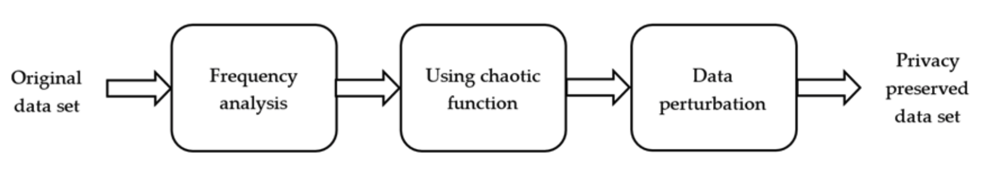
Algorithm 2: data anonymization using chaos and data perturbation techniques

Slide 9
Chaotic Encryption
Combination of Algorithms 1 and 2
Take the Encrypted Data and input it into the Chaos Algorithm and then Decrypt
Overall Ambition for now, may change later.

Slide 10
Challenges
Implementation ⇒
Using two algos to give even more privacy to voters on file, there may be problems with how we chain them together or even just time issues
Accessibility ⇒
There may be issues with how other people access the data, if they are able to decrypt it.
Are these methods understandable to others, how much of a barrier is this to just working with the data.
Fall backs ⇒
We might have to fall back on more reliable and basic methods. (K anonymization)

Slide 11
Other Applications/Malleability
Can be applied to protect Medical Patient information.
Can be applied to Bank and Finance Client information.

Slide 12
Thank you and here are some references!
Suzuki, Tomoya, et al. “Algorithms for Generating Surrogate Data for Sparsely Quantized Time Series.” Physica D: Nonlinear Phenomena, vol. 231, no. 2, July 2007, pp. 108–15. ScienceDirect, doi:10.1016/j.physd.2007.04.006.
Sharma, Ankur, et al. “Longitudinal Single-Cell RNA Sequencing of Patient-Derived Primary Cells Reveals Drug-Induced Infidelity in Stem Cell Hierarchy.” Nature Communications, vol. 9, no. 1, Nov. 2018, p. 4931, doi:10.1038/s41467-018-07261-3.
Nunez-del-Prado, Miguel, and Jordi Nin. “Revisiting Online Anonymization Algorithms to Ensure Location Privacy.” Journal of Ambient Intelligence and Humanized Computing, July 2019. Springer Link, doi:10.1007/s12652-019-01371-6.
Bild, Raffael, et al. “SafePub: A Truthful Data Anonymization Algorithm With Strong Privacy Guarantees.” Proceedings on Privacy Enhancing Technologies, vol. 2018, no. 1, Jan. 2018, pp. 67–87. DOI.org (Crossref), doi:10.1515/popets-2018-0004.

